Slide 1



PIR SENSOR MINI PROJECT
DEPARTMENT OF ELECTRONICS AND COMMUNICATION ENGINEERING
24GCL12 – FOUNDATION LAB – Electrical, IoT and Web
(Internet of Things)
PRESENTED BY
24ECR127 – MITHUNKUMAR A
24ECR129 – MOHANPRASANTH M
24ECR167 – RENGANATHAN K
24ECR172 – SANJAY B
24ECR174 – SANJEEVRAJ BOMMANNAN M
DATE: 26.10.2024
1

Slide 2
OBJECTIVE
To establish a connection between a PIR Motion Sensor and an ESP32 microcontroller for motion detection.
This setup will be integrated with the Arduino Cloud, enabling real-time monitoring and remote data visualization of motion events.
The system is designed for smart home applications or IoT projects, leveraging the cloud platform's capabilities to track motion activity remotely via a user-friendly interface (e.g., mobile app or web dashboard).
The system will provide seamless data transmission, storage, and visualization for enhanced automation and security in smart environments.
2

Slide 3
HARDWARE AND SOFTWARE REQUIREMENTS
Hardware used
BREAD BOARD
ESP32 DEV MODULE
PIR SENSOR
JUMPER WIRES
POWER SOURCE
Software used
ARDUINO CLOUD AGENT
CP210X DRIVER
3

Slide 4
BLOCK DIAGRAM
PIR motion sensor
[Motion sensor]
[Digital Signal]
Microcontroller
[Eg : ESP32 Dev Module]
[Processing]
INBUILT-Wi-Fi Module
[Data Transmission]
Cloud Server
[Arduino cloud]
[Data Access]
User Interface
[Web Dashboard]
4

Slide 5
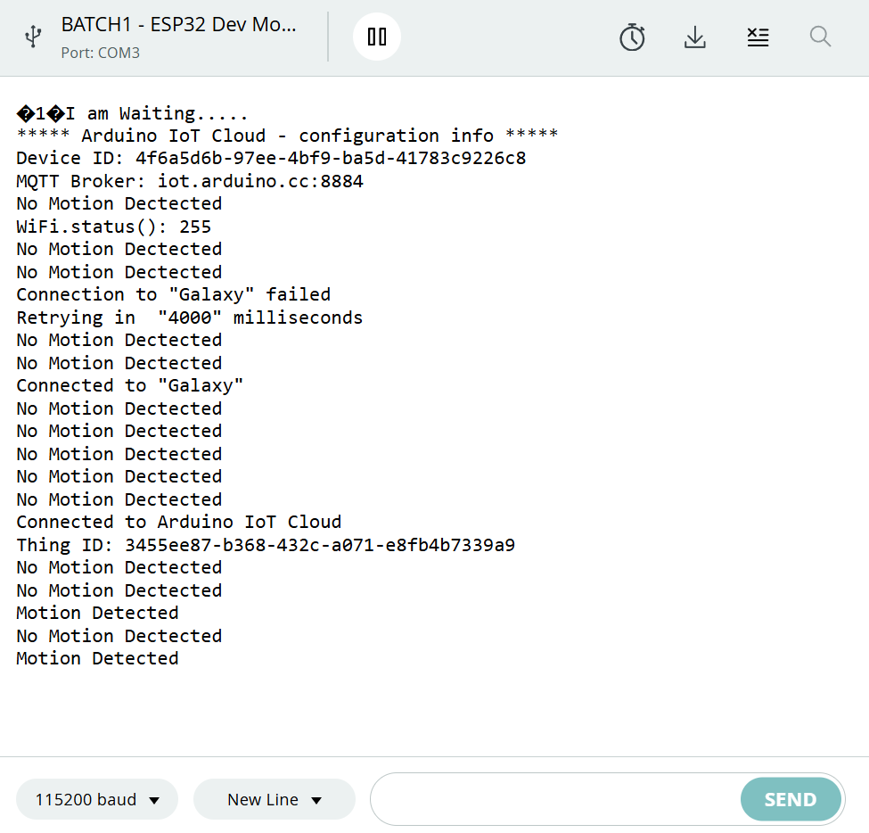
SERIAL MONITOR OUTPUT
5

Slide 6
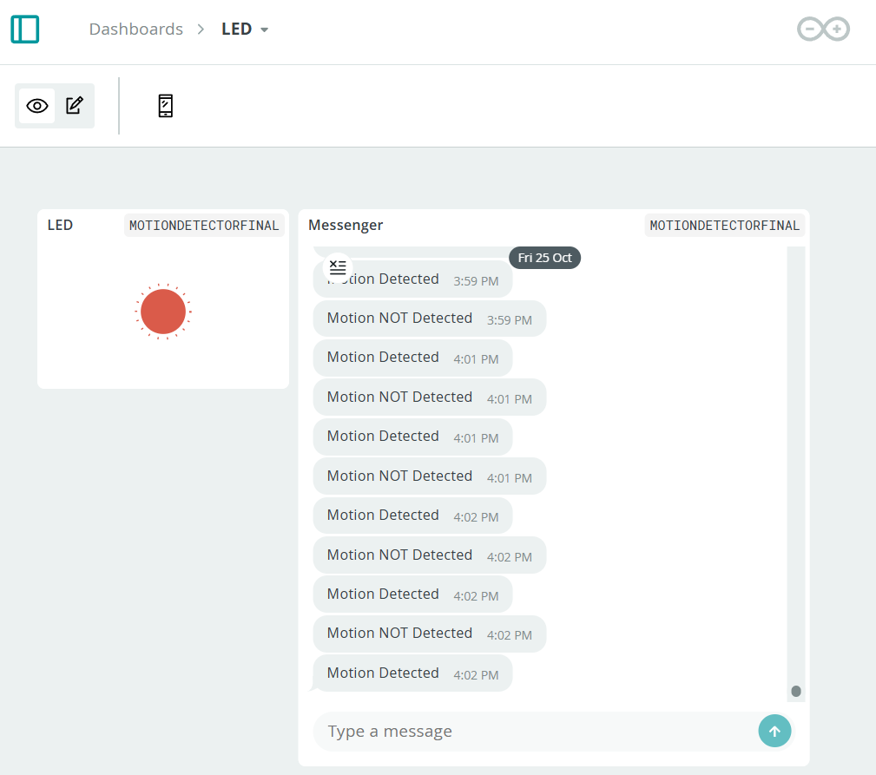
DASHBOARD
6

Slide 7
CONCLUSION
In conclusion, integrating a PIR motion sensor with an ESP32 microcontroller and Arduino Cloud offers an efficient and adaptable foundation for a smart motion detection system.
This setup's real-time remote monitoring capabilities make it ideal for IoT applications in security, automation, and smart home solutions.
The combination of straightforward hardware and Arduino Cloud’s accessible interface provides a robust platform for customization and scalability.
Overall, this project highlights the potential of merging sensor technology with cloud computing to create intelligent, responsive systems tailored to modern connected environments.
7

Slide 8
THANK YOU

